Slide 1


Presented by Mohamed Wahban
Analysis of results
Sales & Profits

Slide 2

Introduction to results analysis
• Analyze sales data (2000+ records) to understand patterns and provide actionable insights to increase.
•The dataset covers sales transactions from 2004 to 2015.
•Key columns include Date, Region, Sales Rep, Customer, Product, COGS, and Sales

Slide 3

Methodology used in the analysis
Microsoft Excel – PivotTables, Calculated Fields, Charts, Trendlines

Slide 4


Overview of expected Outcome :
Identified high-performing products, profitable regions, and sales trends
Suggested strategic actions to boost sales based on data-driven insights

Slide 5
Main approach used in analysis
01.
02.
03.
04.
Descriptive
What happened ?
Diagnostic
Why did it happen?
Predictive
What could happen?
Prescriptive
What should we do?

Slide 6

Descriptive Analysis
What is the total sales amount per customer?
What is the total sales amount per region?
How have sales changed over time (monthly)?

Slide 7
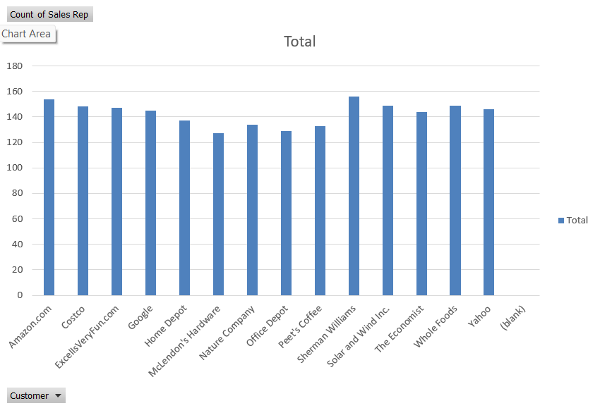
1-What is the total sales amount per customer?

Slide 8
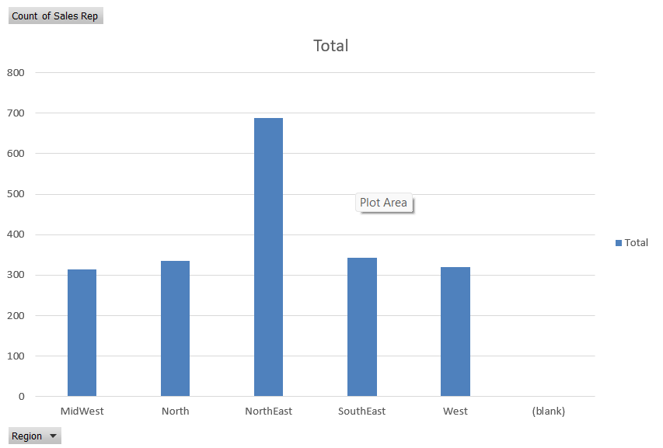
2-What is the total sales amount per region?

Slide 9
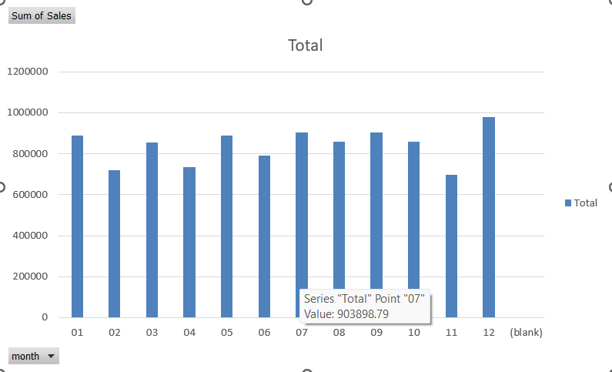
3-How have sales changed over time (monthly)?

Slide 10
Diagnostic Analysis
What is the relationship between COGS and Sales for each transaction?
Which products generate the highest average profit?

Slide 11
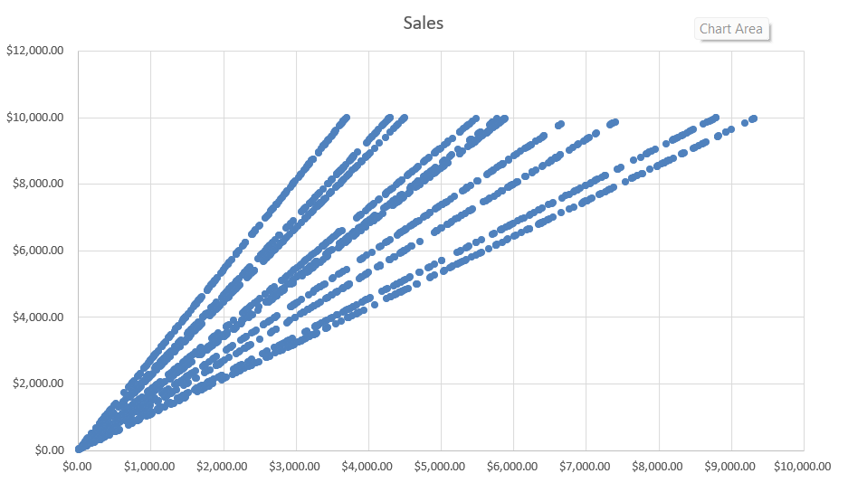
1-What is the relationship between COGS and Sales for each transaction?

Slide 12
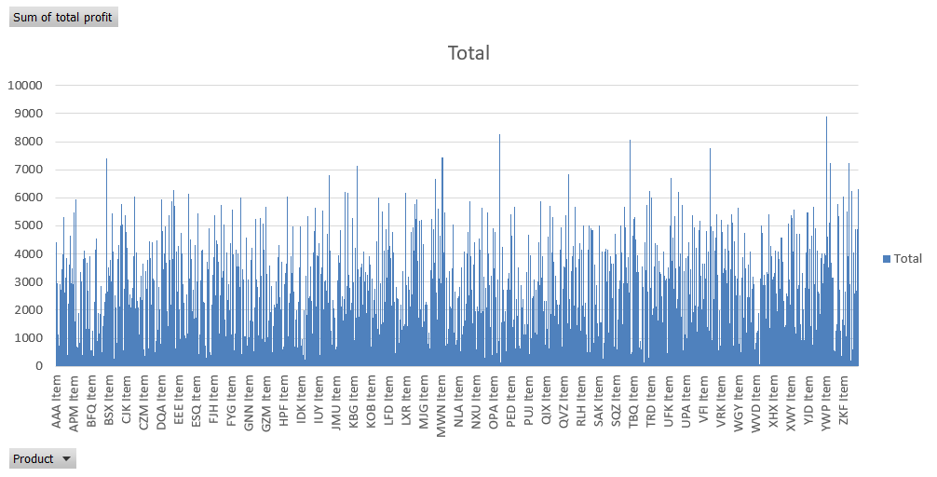
2-Which products generate the highest average profit?

Slide 13

Predictive Analysis
What are the forecasted sales for the upcoming months based on current trends?
Which products of top sellers are showing consistent growth over time?

Slide 14
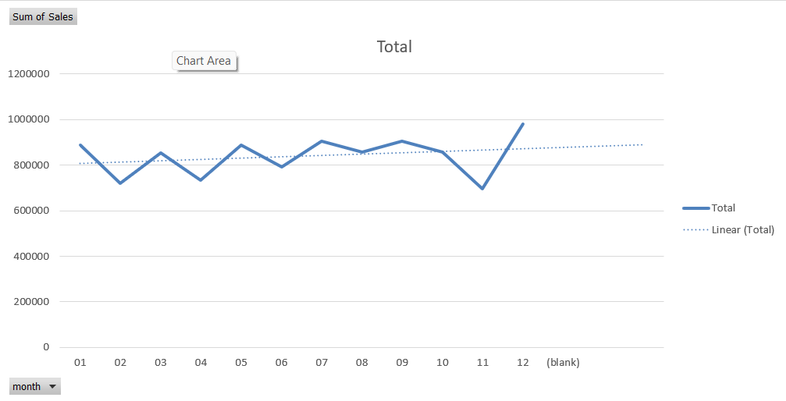
1-What are the forecasted sales for the upcoming months based on current trends?

Slide 15

Prescriptive Analysis
1-Which regions are most profitable and worth expanding into?
2-Which customers contribute the most to total profit? (Pareto 80/20 rule)

Slide 16
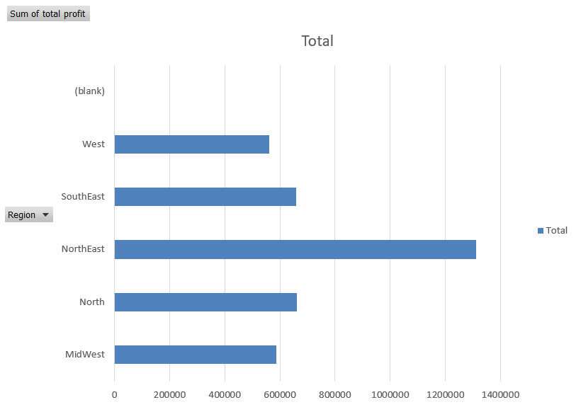
1-Which regions are most profitable and worth expanding into?

Slide 17
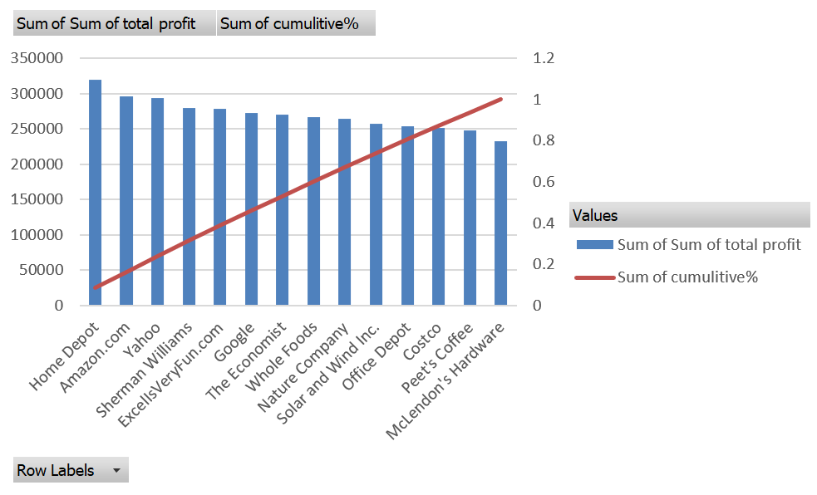
2-Which customers contribute the most to total profit? (Pareto 80/20 rule)

Slide 18

Presented by Mohamed Wahban
Thank you very much!

